Slide 1
Imperialism in Iran and Afghanistan

Slide 2
European Imperialism in 19th Century Iran
Early 19th century Iran included Afghanistan
European interests in Iran were similar:
France sought to compromise Britain’s links to India
Britain wanted links to India safeguarded
Russia needed warm water ports in Persian Gulf
The Nader Shah years were the glory years of Iran
When the Qajar Dynasty came to power in 1794, practically every shah from then until 1924 was inept, unimaginative, superstitious and selfish
willingly ignorant of Europe’s devices
ignored the noble traditions of Shi’i Iran

Slide 3
European Imperialism in 19th Century Iran
In early 19th century, Britain, France and Russia fell all over one another negotiating conflicting treaties with Iran
neither the shah or his advisors were shrewd enough to take advantage of this situation
Russia took a more aggressive tack: in 1812 expanded into the Caucus of Iran and fought the Persians at Aslanduz.
Russians victorious and entered into treaty with Iran

Slide 4
Wahhabiism
In reaction to the state of affairs, some nineteenth century Arabs were embracing a movement that antedated Western imperialism: Wahhabiism
Muhammad al-Wahhab traveled the Ottoman empire observing a tottering and sick society toward the end of the eighteenth century
“I roamed in the lands of the infidels and have beheld their cities and mansions”
“I also traveled in the realm of Islam and all I saw was ruins”
compared with the Quran, the world of Islam was wanting
He advocated a return to strict living according to the Quran.

Slide 5
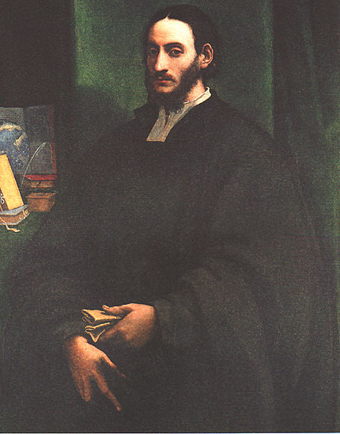
Wahhabiism
Wahhab rejected mystic beliefs of Shi’i, shrines, rosaries and legitimacy of Ottoman sultan-caliph
He preached Islam had been polluted by non-Arabs, especially Persians and Turks
His disciples were called Muwahhidin (Wahhabis) and were strict observers of Shari’a of Quran and Sunna of the Prophet
They labeled corrupted Muslims as “polytheists” and took to the sword in converting these
In 1773, Wahhabis took Riyad as they set about to stir Islam out of a period of jahiliyya or “ignorance”

Slide 6
Wahhabiism
By 1800, with the help of the Sa’ud family, Wahhabis captured Mecca and Medina and set about to invade Karbala and Najaf to the north
Desperate, the Ottoman sultan appealed to Muhammad Ali, pasha of Egypt to quell the rebellion in 1811.
Over several campaigns, Muhammad Ali’s son Ibrahim subdued the Wahabbis and recaptured Mecca and Medina in 1818.
Wahhabis continued to harass the sultan throughout the 19th century until Sa’ud family were driven into exile in Kuwait in 1891.

Slide 7
Al-Afghani (1839-1897)
the most prominent pan-Islamist of the nineteenth century was Jamal al-Din al-Afghani
although a Shi’i Persian, he claimed to be a Sunni Afghani. His goal was the revival of the glory of Islam
Vehemently anti-British, he considered Britain to be the main enemy of Islam.
He was an effective and restless agitator, although he failed to find a strong Muslim ruler who would champion the cause

Slide 8
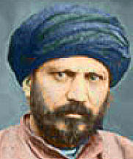
Al-Afghani
believed in the importance of reason and that the Quran contained hidden references about modern inventions such as the steam engine
man had to apply reason to understand the word of Allah
Islam was power and only incidentally faith
“Islam needs a Martin Luther”
politically he was a better activist than leader, willing to use any means to attain his purpose
he endorsed the death of those who opposed him

Slide 9
Al-Afghani
Al-Afghani’s plan was to bring about a unified Islam:
shah of Iran to recognize the Ottoman sultan as caliph
sultan would recognize the independence of Iran and cede the holy Shi’i cities Karbala and Najaf to Iran
convene a pan-Islamic conference in Istanbul for the purpose of declaring jihad against European powers
Al-Afghani used various leaders until it was clear they would not support his cause. He went to:
Khedive of Egypt, Shah of Iran, and Sultan Abdul Hamid of Ottoman Empire
the wily sultan kept him under house arrest until he died of cancer in 1897.

Slide 10
Iran Enters Into Bondage
After a series of wars with Iran in 1812 and 1825, the Russians annexed Persian territories around the Caspian Sea
Through peace treaties, the Qajar shah in effect invited Russia to interfere in internal affairs of Iran.
British fears of an attack on India were intensified by these events, suspecting Russia was “on the roll”
Sought to secure region in Afghanistan
Persians claimed suzerainty over Afghanistan but British did not think Iran was strong enough to prevent Russia from thrust through this region

Slide 11
British Claim Afghanistan
While Iran sought to secure their hold on Afghanistan, the British opposed it, thinking the Qajar shahs had Russian sympathies
This came to blows in 1848, Naser al-Din became Shah at age 16. He boldly sent Iranian forces and occupied Herat, Afghanistan
the British declared war on Iran and thrust out the Persians
A treaty of peace was concluded in Paris in 1857
Iran agreed to evacuate Afghanistan and recognize its independence
Any further disputes between Afghanistan and Iran would have to be mediated through British offices
British secured a good position in Hindu Kush mountains of Afghanistan to control the region

Slide 12
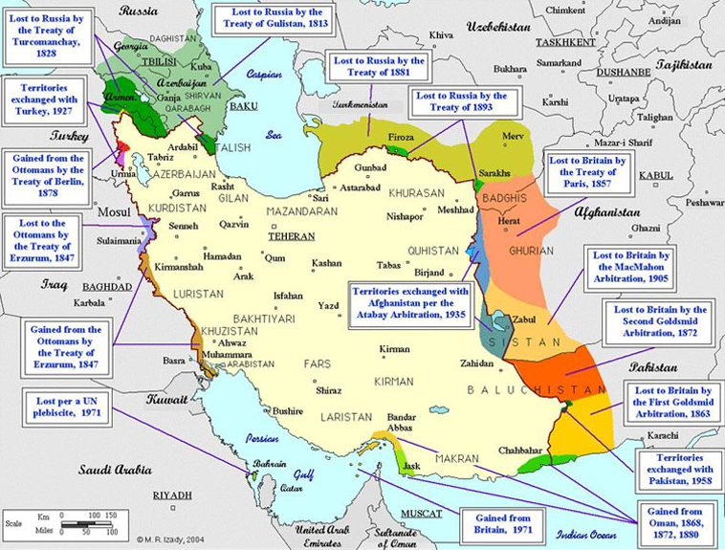

Slide 13
The “Great Game”
Rudyard Kipling mainstreamed this term referring to the period of rivalry between the Russian and British Empires in Central Asia
Hindu Kush mountains have had military significance from the time of Cyrus the Great until the present
Main history of Iran from 1828 to early 1900s is story of slow advance of Russia from northeast and Britain from southeast
Iran itself was spared of being wholly annexed not because of the strength of Qajar shahs but because neither Russia or Britain would allow the other to do it

Slide 14
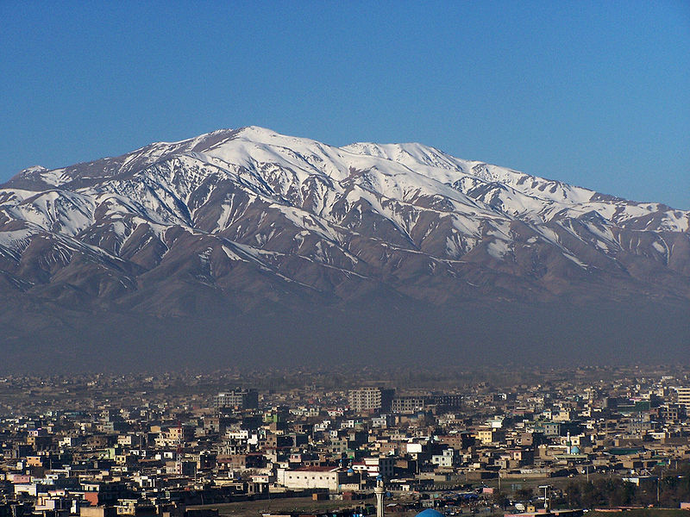

Slide 15
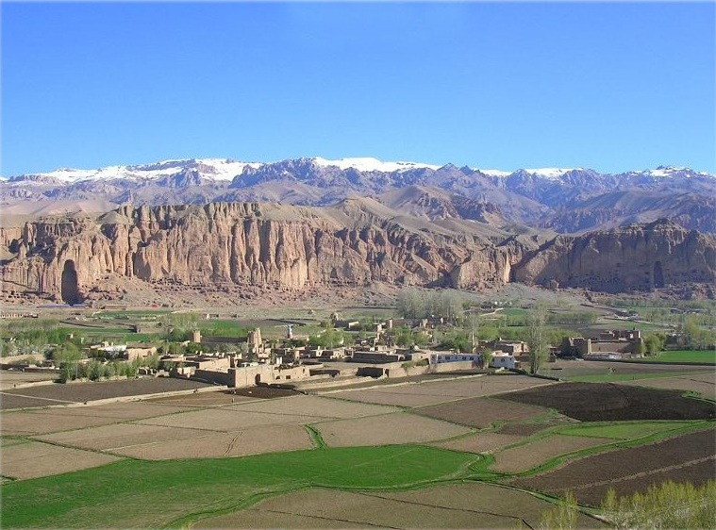
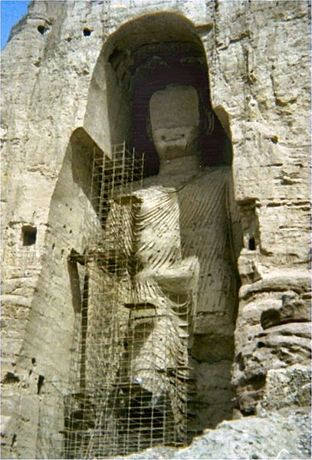

Slide 16
Economic Imperialism
Although neither Russia or Britain allowed its rival to annex more territory, their dissection of Iran continued with an economic phase in 1870-1921
This was precipitated by the Indian Mutiny in 1857
British government took over formal control of India
To connect London and Delhi by telegraph, it was necessary to pass through Iran
Indo-European Telegraph Company formed 1870
Connected Tehran with Tabriz and Odessa
Effectively ended isolation of Iran and opened the way for other concessions

Slide 17
Economic Imperialism
The Russians, not to be out done, demanded equal treatment
Over the next 40 years, concessions and loans from Britain and Russia gradually put the resources of Iran under foreign control
Culminated in discovery of oil in 1900
Tobacco Regie of 1890 gave British a monopoly of production, sale and export of all Persian tobacco
Naser al-Din Shah received annual £15,000 and ¼ of profits
Aroused vehement resentment/antagonism from people of Iran
Ulama opposed foreign intrusions and sponsored protests
Shah attempted to imprison critics
Shi’i mujtahid issued a fetwa forbidding Persian Muslims to smoke until concession was revoked, forcing the shah to comply

Slide 18
Shah Assassinated
Persians realized the power of the shah was not insurmountable. This was an important step toward the establishment of a constitutional monarchy.
Afghani made common cause with the ulama against the shah but was expelled from Iran
In Istanbul, al-Afghani continued pan-Islamic, anti-shah activities
In 1896, while Naser al-Din Shah attended the shrine of Shah Abdul Azim, he was shot to death by Afghani’s disciple, Mizra Reza

Slide 19
Revolution by Accident
The new shah, Mozaffar al-Din, cared nothing for ruling except to go to Europe and be wined and dined by the other crowned heads of state
racked up heavy expenses for already failing economy
opportunist Grand Vazir Amin al-Sutan was real power behind the throne curried favor of Russia or Britain as situations dictated
As soaring inflation and government policies favored foreign powers, indignant Persian merchant rose up in protest, called for strike & closed bazaars

Slide 20
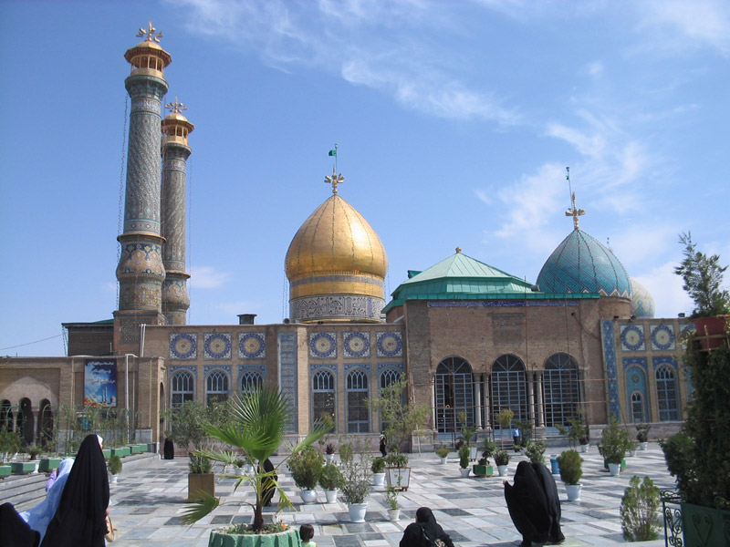
Revolution by Accident
The government retaliated by flogging merchants
December 13, 1905, two mujtahids led thousands of ulama and merchants to sanctuary in shrine of Shah Abdul Azim
demanded a “house of justice”
The shah promised to comply but never made it good

Slide 21
Revolution by Accident
While European powers continued to economically gut Iran, the country was divided:
quarrels between Russian-favoring Persian officials and British-favoring Persian officials erupted while a general awakening of the population called for “House of Justice”
large crowds took sanctuary (bast) on grounds of British Legation in Tehran
British recognizing tenuous predicament of shah saw an opportunity to best Russia sided with the “revolutionaries” (though they had not intended to be)
The new shah granted the request on August 5, 1906
limited power of monarchy
established an elected assembly or majles
created regulations for governing
In the following year, a constitution was drafted

Slide 22
Fragile Reform
Everything fell into jeopardy when the ailing shah died in 1907
the new shah was a mere puppet of Russia, which opposed the revolution
he selected Amin al-Sultan as prime minister, who was all too happy to see the revolution die
In response, there formed hundreds of Anjomans throughout Iran which were public councils which tried to carry on the revolution
since they had no central leadership, each had its own rules, some resorted to terrorism

Slide 23
Spheres of Influence
After leaving the Majles, where he pushed get loans from Russia, Amin al-Sultan was shot dead by a member from a terrorist Anjoman on Aug 31, 1907
Britain and Russia reacted with indignation against revolutionaries and with Kaiser Wilhelm seeking to get a foot in the door:
in the Anglo-Russian Convention of 1907 they agreed to show a “united front” against rising Germany with respect to Iran, Afghanistan and Tibet
designated “spheres of influence” with Russia taking the region to the north and the British the region to the south east (the rest was considered “neutral”)
the revolutionaries felt betrayed

Slide 24
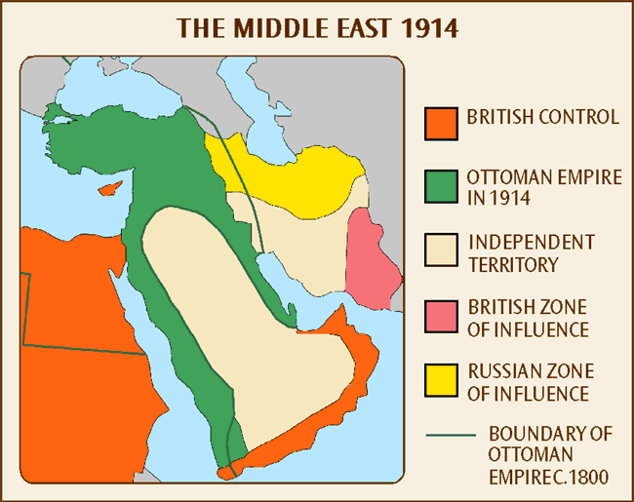
Spheres of Influence

Slide 25
Crackdown in Iran
New shah appealed to the Russians for help with the revolutionaries
a Cossack regiment under Col Liakhanov bombarded the Majles by order of the shah
some revolutionary leaders were arrested and executed, while others fled into exile
When all seemed lost, the city of Tabriz refused to let Russian and the shah’s troops enter and remained under siege for 9 months
American missionary school teacher Howard Baskerville and his students lead dangerous sorties to obtain food for the city. He was killed April 21, 1909

Slide 26
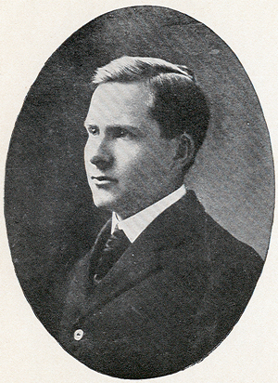
Howard Baskerville 1885-1909
American Presbyterian Missionary
Came to Tabriz in 1907 to teach at a missionary school
In the spring of 1909, he decided to raise a volunteer force to defend constitutional democracy. Despite attempts to discourage him by the American consul in Tabriz, he led about a hundred volunteers attempting to help defend the besieged city against Qajar royalist troops.
Baskerville was shot and killed by a sniper while leading a group of student soldiers to break the siege.

Slide 27
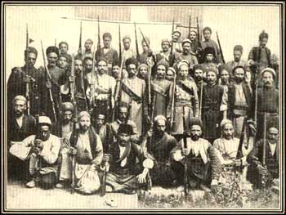
Tide Turns
Tabriz gave the revolution the time needed
Bakhtyaris tribe supplied forces to support the constitution and advanced on Tehran from the south
In Rasht, an army of volunteers for the revolution assembled and converged on Tehran from the north
many of their ranks were Armenians
these forces entered and took the capital city on July 13,1909.
shah was deposed
constitution and Majles reinstated on Nov 15, 1909
the siege of Tabriz was lifted

Slide 28
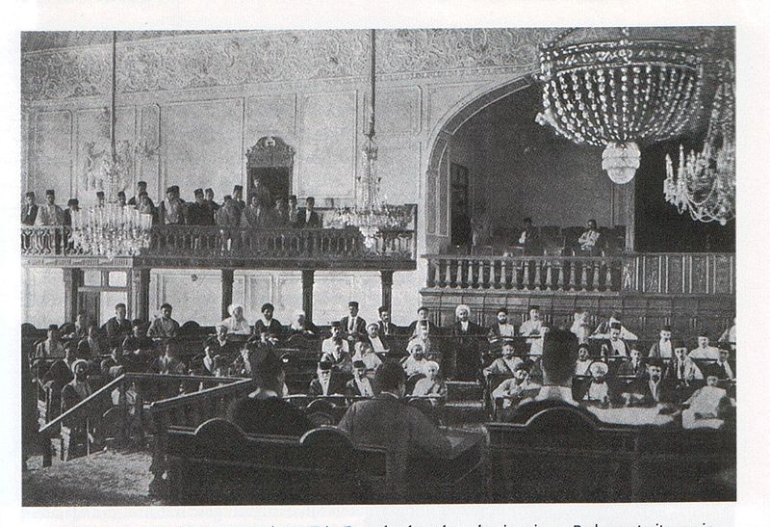
Majles

Slide 29
Fragile Democracy
The was a rift in Majles by two opposing parties:
Social Democrats wanted separation of government and religious powers, constitutional government based on laws passed by elected representatives of people
Social Moderates consisted of ulama and nobility who wanted rule of Shari’a
The rift became violent at times:
ulama from Najaf excommunicated Social Democrats
moderates were assassinated by secret Anjomans
Majles sought for expert financial advise for the struggling democracy
because of the influence of American missionaries such as Dr. Joseph Cochran, they turned to the US for help
Morgan Shuster and his group was sent to assist Iran as Treasurer-General

Slide 30
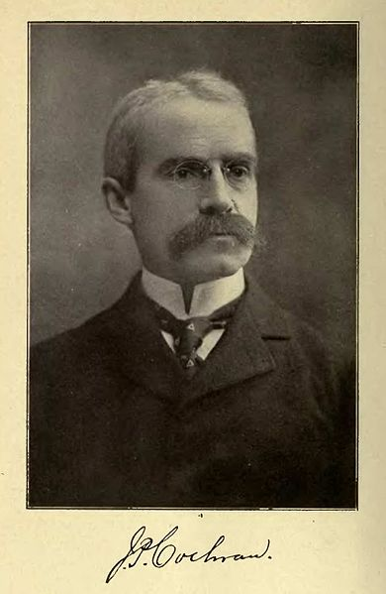
Dr. Joseph Cochran
The son of American missionaries in Iran, Joseph returned to Iran with his wife Katherine in 1878 after completing Medical School
established 100-bed hospital in Urmia in 1879 and faced with dreadful shortage of staff, started the first medical school in Iran.
The Medical School in Urmia closed with Dr. Cochran’s death in 1905 but reopened in 1965.

Slide 31
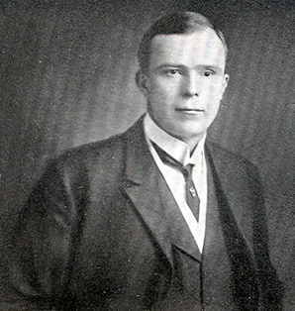
Morgan Shuster
Shuster became active in supporting the Constitutional revolution of Persia, replaced the Shah's brother, who was aligned with the goals of Imperial Russia in Persia, as Treasurer General. Shuster realized the country would have sufficient revenue if taxes were paid regularly.
Russia issued an ultimatum in November 1911 demanding Iran dismiss Shuster. This was ignored. Russia immediately landed troops in Bandar Anzali demanding a recourse and apology from the Persian government.
Iran appealed to Britain for help but instead was advised to comply with the ultimatum while Britain brought Indian troops into southern Iran
“[I]t was obvious that the people of Persia deserve much better than what they are getting, that they wanted us to succeed, but it was the British and the Russians who were determined not to let us succeed.”
Morgan Shuster

Slide 32
Revolution Fails
The finest hour of the revolution came when the Majles voted unanimously to reject the ultimatum.
The revolution lost its chief allies when the Bakhtyari tribe reinstated the cabinet of the shah
The cabinet closed the Majles and dismissed Shuster on December 24, 1911
Thus ended the constitutional revolution. It failed because of the rift between the nationalists and the ulama, the tremendous pressure exerted by Britain and Russia and the inexperience in government and finances.
During World War I Iran sided with Germany and Austria because of distrust for Russia and Britain

